Slide 1
Fluid Power Challenge:
Workshop Day – January 31st, 2025
8th
Annual
Please come in, locate your table and have a seat.
DO NOT open the boxes on your table, we will do this together.

Slide 2
Fluid Power Challenge:
Workshop Day – January 31st, 2025
8th
Annual
PRESENTERS:
Bill Haley – FORCE AMERICA Wayne Buroker – WCTC
James Foster – NFPA

Slide 4
Waukesha County Technical College
The Pewaukee campus encompasses more than 10 buildings spread out over 140 acre.
Additional campuses are the downtown Waukesha campus and the Sky Plaza campus
WCTC offers students more than 150 areas of study.
Many of these programs are technical diplomas or associate Degrees that have fluid power classes
Dual Enrollment Academy is also offered to high schools

Slide 5
WCTC Housekeeping
Rest Rooms
Emergency Exits
Facility Utilization
Workshop
Lunch

Slide 6
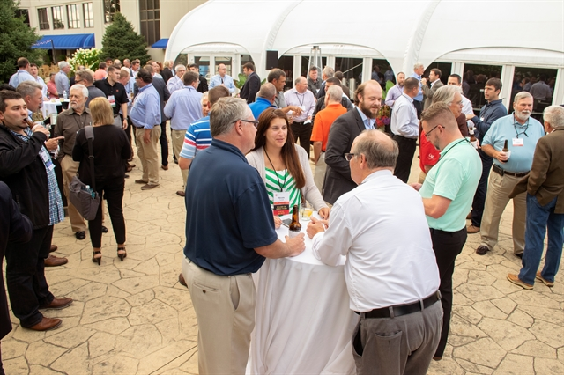
About NFPA
Founded in 1953, the National Fluid Power Association (NFPA) is the only trade Association focused exclusively on fluid power technology with members representing the entire fluid power supply chain.
Beginning with 35 fluid power companies at the inaugural meeting on May 1, 1953, NFPA has grown to over 340 member companies with an ever-growing impact towards ensuring fluid power is the customer’s technology of choice.
Headquartered in Milwaukee, WI, NFPA continues to add value for its members and is working towards the continued success of the fluid power industry.

Slide 7
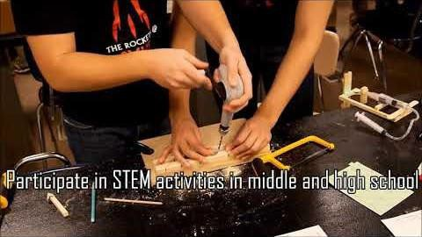

Slide 8
PARTICIPATE IN THE FLUID POWER ACTION CHALLENGE
TAKE CLASSES IN HIGH SCHOOL
APPLY FOR $2,000 SCHOLARSHIPS TO ATTEND WCTC
GRADUATE AND START YOUR CAREER

Slide 9
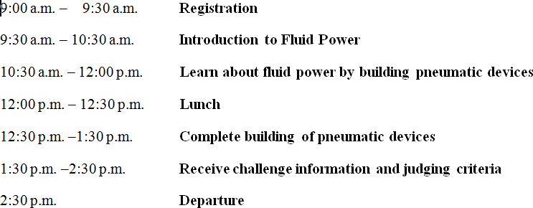
Workshop Day Agenda

Slide 10
THE WORKSHOP DAY OBJECTIVES:
The students will:
Complete the Pre-Survey
Watch a video and learn about fluid power
Explore the tools and materials
Use the tools to make the Lifter and the Rotating Arm Kits
Be introduced to the Challenge
Made aware of the importance of the Portfolio
Be encouraged to ask questions regarding the Challenge
Understand what is required of them before the Challenge
Know what to bring to the Challenge

Slide 11
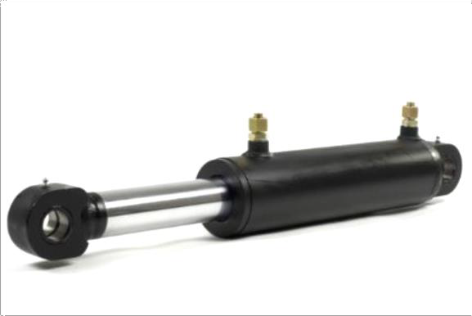
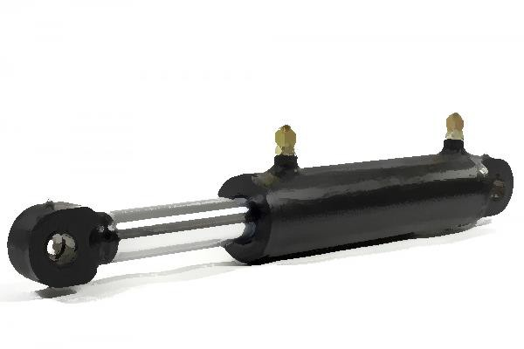
Discovering Fluid Power
Video link:
A-Force-for-Change

Slide 12
Introduction to Fluid Power

Slide 13
Merriam-Webster Dictionary

Slide 14
Fluid
Liquid
Gas
Water
Oil
Air
Nitrogen
Hydraulics
Pneumatics
What is a Fluid?

Slide 15
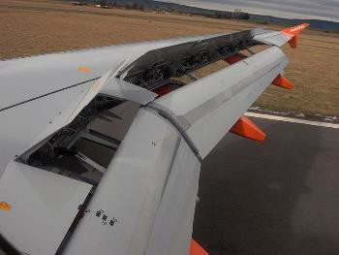
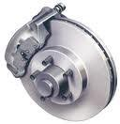
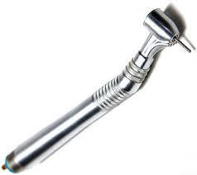
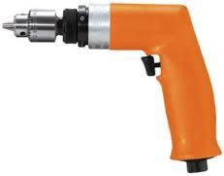
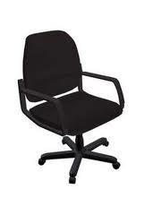
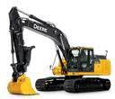
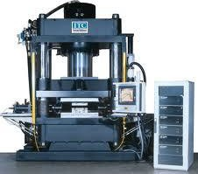
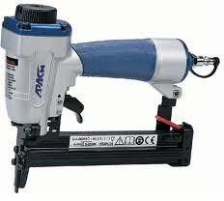
Hydraulics
Examples of Fluid Power
Pneumatics
Airplane Flaps
Automotive Brake
Dentist Drill
Pneumatic Drill
Excavator Hydraulic Press Office Chair
Advantage and disadvantage to each? / How far away is the power source for each?
Nail Gun

Slide 16
What is Pressure?
Molecules
Pump Tank
Hose
Pressure is eventually the same everywhere

Slide 17
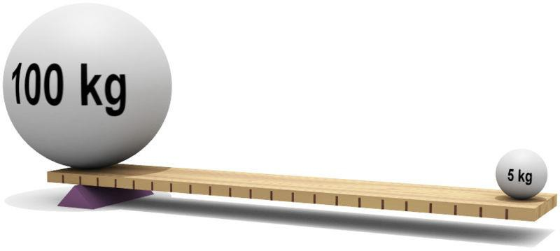
What is Mechanical Advantage?
Image Source: en.wikipedia.org/wiki/Lever

Slide 18
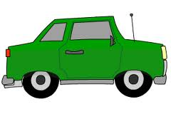
What is Mechanical Advantage? e.g. Hydraulic Lift
100 lbs
1900 lbs
Piston Area = 20 in²
Piston Area = 1 in²
Pressure = ?
Notes:
Use 60ml and 10ml syringe to demonstrate mechanical advantage.

Slide 19
Pneumatic Cylinder
Diameter
Pressure P
Area
Force F
Side View of Cylinder
Cross Section of Piston
How much force is exerted by the piston?
If pressure = 60 psi and diameter = 1 inch:
Area = pi x (1 in)² / 4 = 0.785 in²
Force = (60 psi) x (0.785 in²) = 47 lbs.

Slide 20
Explore Tool Kits!
SAFETY FIRST!
WEAR SAFETY GLASSES NOW!
Don’t Open Workshop Kits Yet!

Slide 21
Safety
Safety is everyone’s responsibility!
Always wear safety glasses
Yes - even when not cutting or drilling
No Running, No Throwing, No Horse Play!
When sawing, drilling, filing or sanding;
Ensure the mitre box is securely clamped down
Ensure each workpiece is secure & stable
Ensure your hands/fingers are out of harms way
Wipe sawdust, don’t blow
Questions?

Slide 22
Verify Tool Kit Contents
Item Description | Quantity
Bench Hook/Mitre Box (double-sided, 7/16" slots) | 1
C-clamp (3") | 1
Acrylic Ruler (with 1/16" inch divisions) | 1
Junior Hacksaw | 1
Hacksaw blades (fine, single) | 1
Scissors (5` rounded, 1 pr) | 1
Craft drill | 1
Wood drillbit 3/16" (brad pt) | 1
Round file with handle (1/4" diam.) | 1
Safety Glasses clear lens | 4
Mini low-temp Glue Gun, 10W | 1
We will be collecting all the glue guns, these are for Challenge Day
What is the bench hook for? What in this kit could hurt you or others?

Slide 23
Construction Tips
Have a plan
Measure twice, cut once
Accuracy is important
Wood Glue
Less is more!
Excessive glue takes longer to ‘set-up’ & does NOT result in a stronger joint
Use stick to spread out glue on contact surfaces
Use gussets and structural members for strength
Consider Center of Gravity

Slide 24
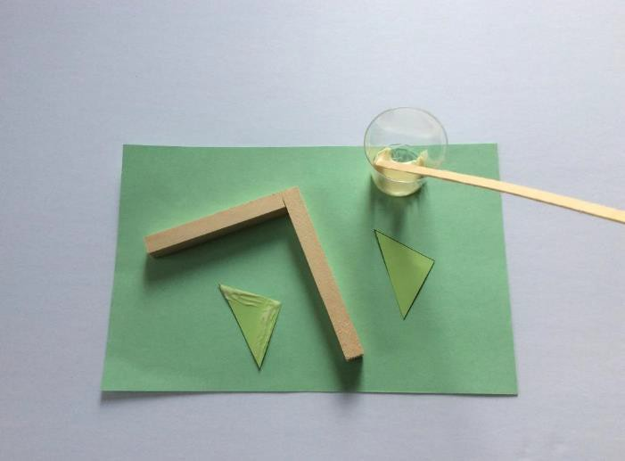
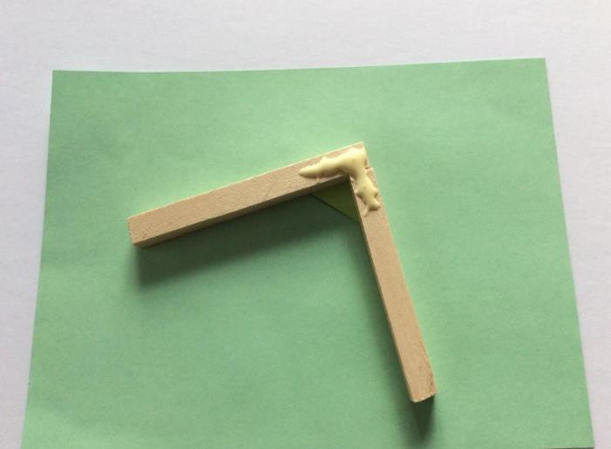
Using Wood Glue
Use the glue cup and stirring stick to apply glue sparingly (less is more)
√
X

Slide 25
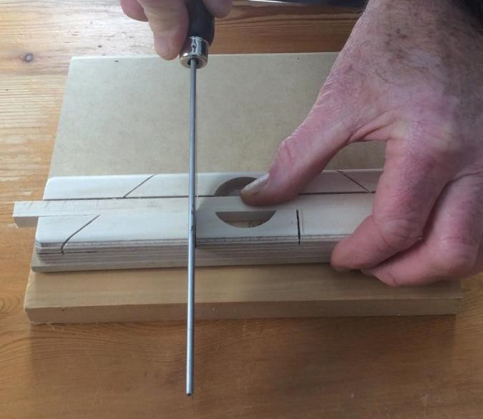
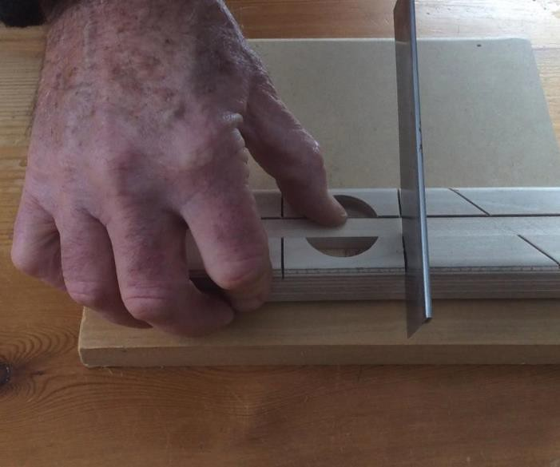
Using the miter box and hand saw to cut wood
RIGHTY
LEFTY

Slide 26
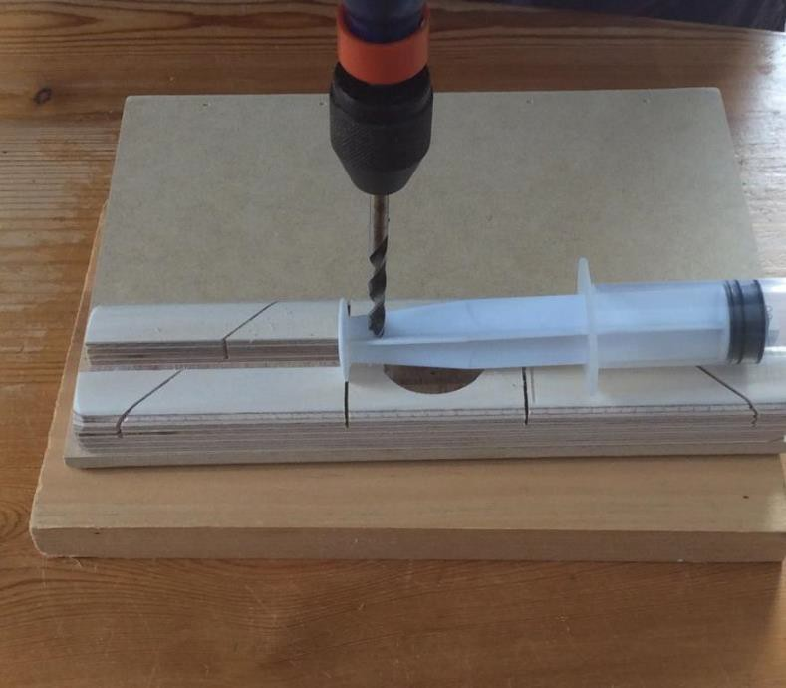
Using the hand drill to drill a hole in a syringe
Keep the drill upright – ask your partner to make sure and lend a hand to keep the piston syringe still.
Press down while drilling. To remove the drill bit from the hole rotate in the same direction and pull the drill up.

Slide 27
Divide Tasks
Elect Group Leader
Assign Roles (For example):
Leader (Check progress of parts and help where needed)
Wood Cutter / Arm Builder
Cube Maker
Gussets & Glue
Without dividing tasks and working in parallel, you won’t complete the activity. (Same on challenge day)

Slide 28
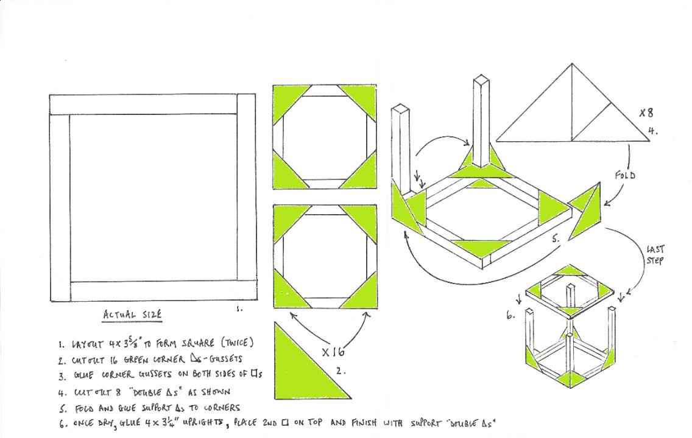
Making the cube

Slide 29
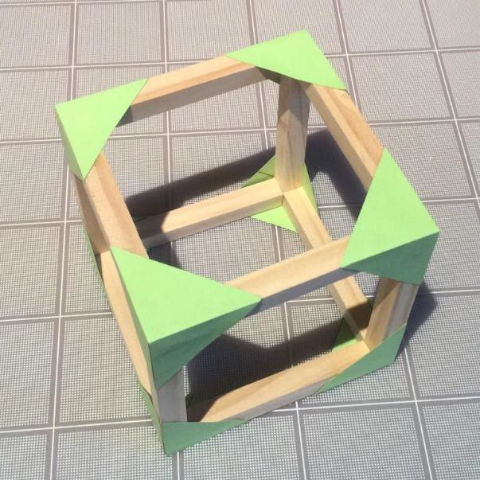
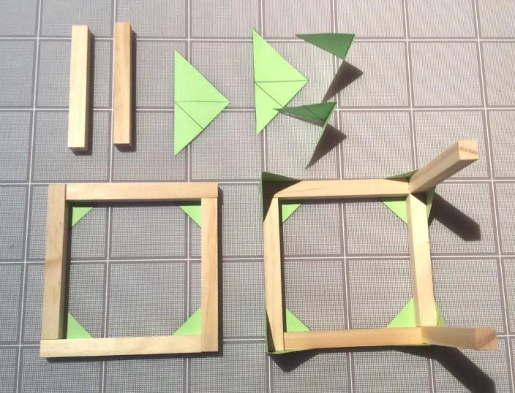
USE DOUBLE GUSSET

Slide 30
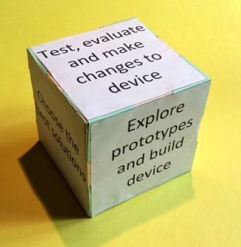
Glue the sides on the Cube

Slide 31
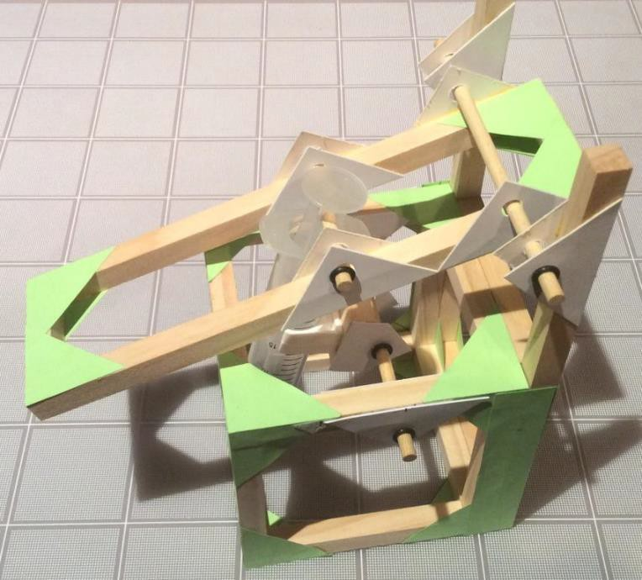
Build the Lifter

Slide 32
Lifter Kit – Bill Of Materials
Item | Quantity | Description
1 | 7 | 12” Wooden pieces (⅜” cross-section)
2 | 2 | Cards of green corner gussets
3 | 2 | 20cc Syringes (1 has a hole in the plunger)
4 | 1 | Length of plastic tubing
5 | 2 | 5” long 3/16” Wooden Dowel
6 | 1 | 3” long 3/16” Wooden Dowel
7 | 16 | White Cardboard Axle Holders
8 | 1 | Syringe Holder
9 | 8 | Mini-washers
10 | 2 | Stirring Sticks
11 | 1 | Small piece of sand paper

Slide 33
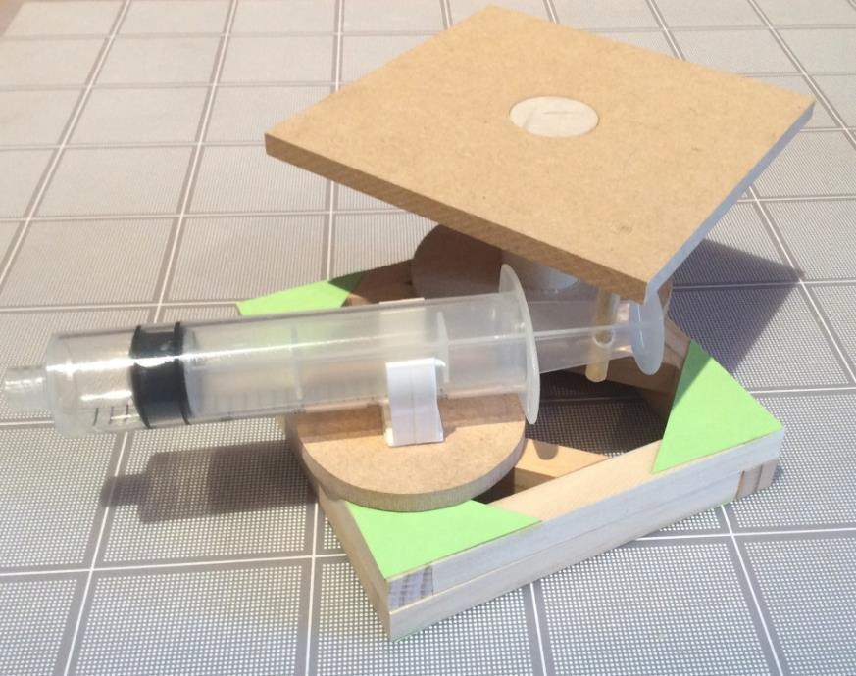
Build the Rotating Platform

Slide 34
Rotational Arm Kit – Bill of Materials
Item | Quantity | Description
1 | 4 | 8” Wooden pieces (⅜” cross-section)
2 | 1 | 10” Wooden piece with 3 holes
3 | 2 | 20cc Syringes (1 has a hole in the plunger)
4 | 1 | Length of plastic tubing
5 | 2 | 1½” long 3/16” diam. Wooden Dowel
6 | 1 of each | ⅝” & 2” long 3/16”diam. Wooden Dowel
7 | 7 | White Cardboard Axle Holders
8 | 1 | Syringe Holder
9 | 3 | Mini-washers
10 | 1 | Card of green corner gussets
11 | 1 of each | Small piece of sand paper & stirring stick

Slide 35
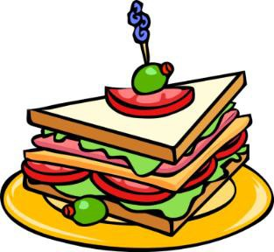
30 Minutes For
Lunch!

Slide 36
Lifter Kit – Reflection
What was the hardest part to build?
What was the most difficult part to coordinate?
Why did we ask you to build this lifter as part of the challenge?
How can you make the process more efficient?

Slide 37
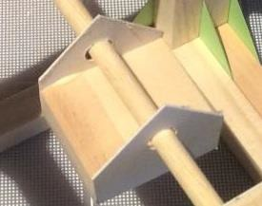
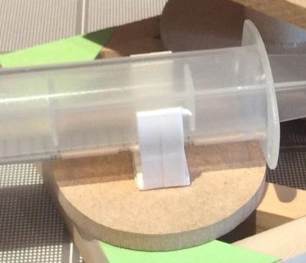
Using the piston-syringe clips
The #1 reason why devices fail is because the clips are not fixed correctly to the device. A platform must be used to accommodate movement and the clips must be placed on card, this being glued to the wooden frame. Use the gray clips where a greater force is required. Push the clips firmly onto the card base once the glue is dry.
Using hot glue is not a good alternative.

Slide 38
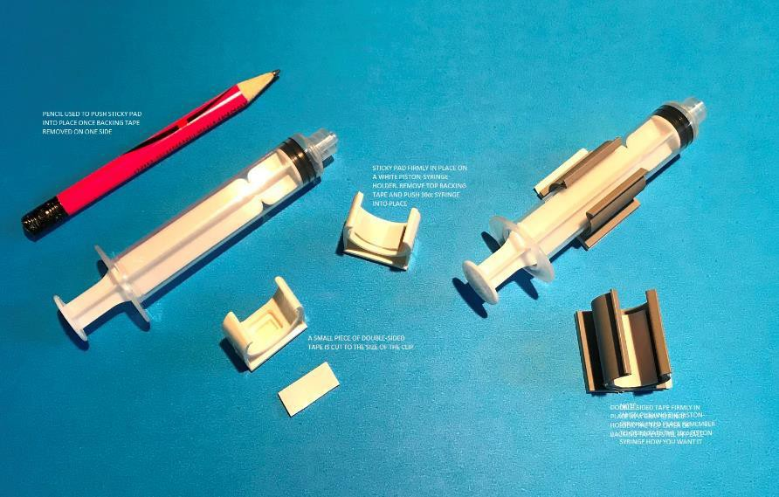
Connecting the 10cc piston- syringe to white and gray clips
Use a piece of double- sided tape cut to the size of the clip. Peel off one (1) side of the tape and insert firmly into clip.
Chose the orientation of the barrel of the piston syringe, peel off backing tape and press firmly into place.

Slide 39
The Challenge
7th March 2025

Slide 40
REVIEW THE FOLLOWING DOCUMENTS:
Rules for Challenge Day
The Current Challenge
Challenge Rubric
Portfolio Checklist
Portfolio Template
Isometric/Orthographic Drawings

Slide 41
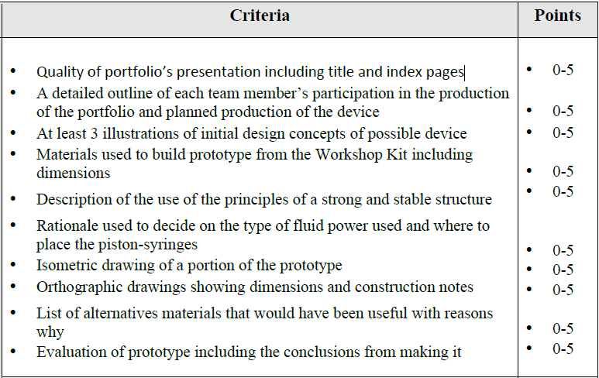
The Challenge – Portfolio Rubric

Slide 42
MAXIMISE YOUR TEAM’S PORTFOLIO POINTS (45 Available)
A detailed outline of each team member’s participation in the production of the portfolio and planned production of the device
Think about your team – who is good at what?
Think about how long you have to design and build your prototype and record the
process in your portfolio
At least 3 illustrations of initial design concepts of a possible device
However, detail helps you think about the connecting parts!
At least 3 illustrations of initial design concepts of possible device
Record the parts you use and their dimensions
List of alternative materials that would have been useful with reasons why they would have been so
This is asking you to think “outside the box” literally

Slide 43
Weight
Glue
Weight
Option #1
Option #2
GROUND
Structural Strength
Which Option is a more structurally sound Design? -- Why?
What else can go wrong and how do we improve it?

Slide 44
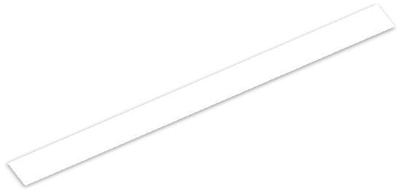
Paper Gussets
Wooden Cross Brace
Weight
Weight
Force
Force
Option #1
Option #2
GROUND
Structural Strength
Observations? Pro’s and Con’s of each option?
Reasons to use one option vs another? Other Considerations?

Slide 45
Pivot Shaft
Load
2lb
Arm
1lb
Base
½lb
GROUND
Structural Stability
Any concerns with this structure?

Slide 46
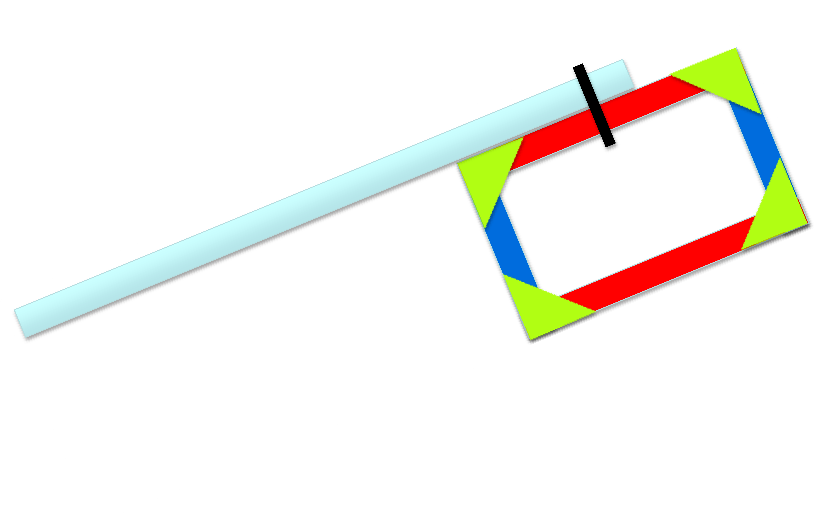
GROUND
Structural Stability
The device will tip over - Why?
How do we prevent this?

Slide 47
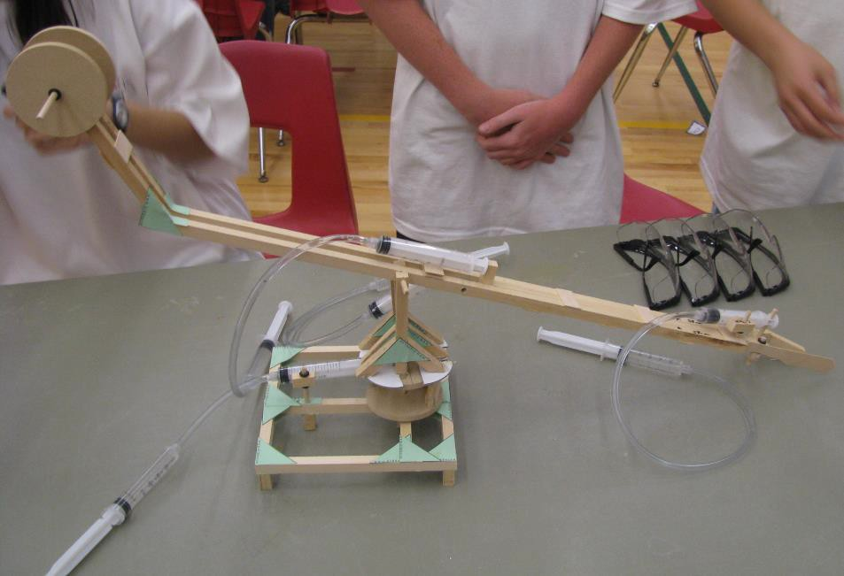
Placement of Hydraulic or Pneumatic Systems
An elegant design where the actuating pistons (the pistons that attach to the device) are efficiently placed to maximise movement

Slide 48
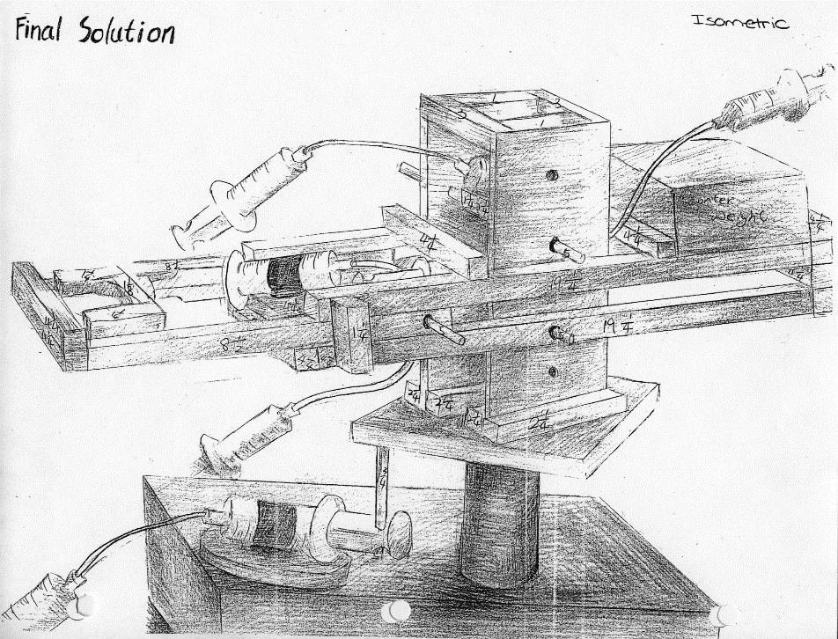

Slide 49
Orthographic & Isometric Lesson
Curriculum
Plot Frame Criteria & Purpose
Orthographic View Creation & Methods
Isometric View Creation & Methods
Hidden Lines & How They Are Used
Practice Exercises

Slide 50
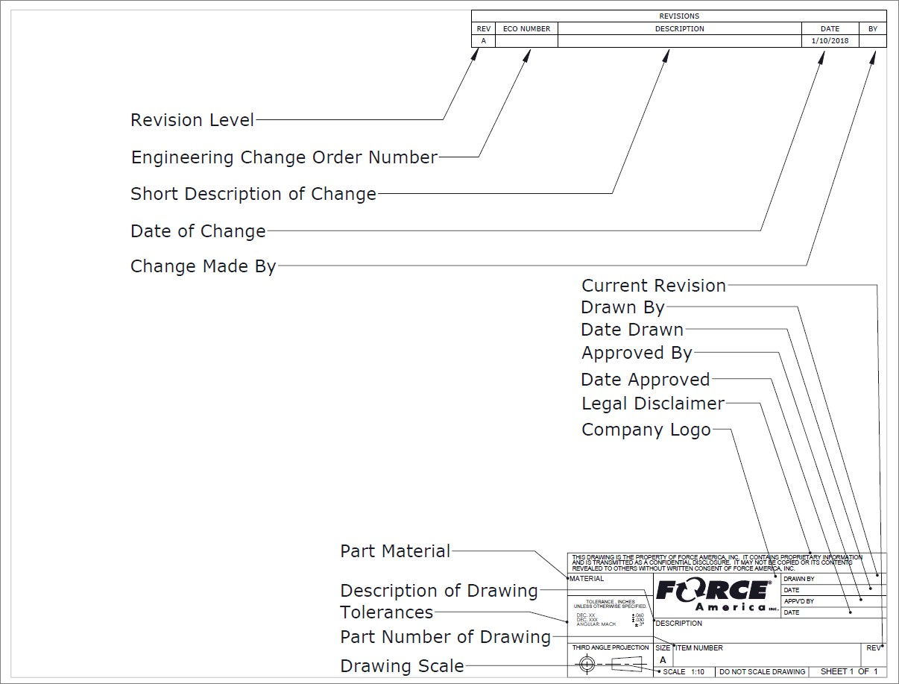
Plot Frame Criteria

Slide 51
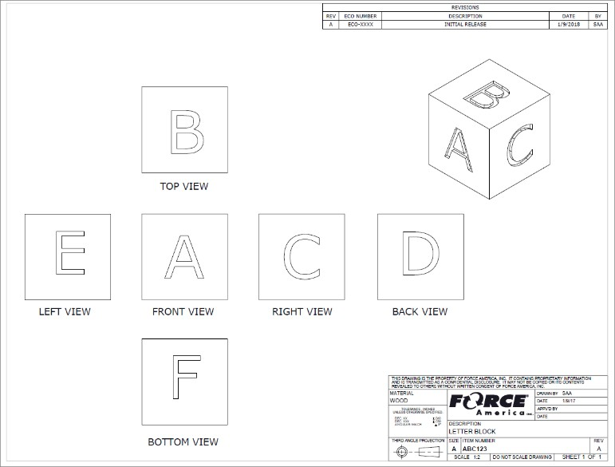
Orthographic Projection
Orthographic means single view. Each of the 6 images is an orthographic projection of a different side. Most drawings will only show the necessary amount of sides with the minimum being 3.

Slide 52
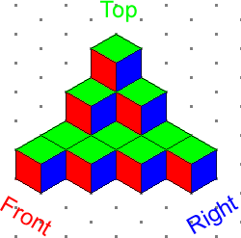
Orthographic Projection
Isometric View

Slide 53
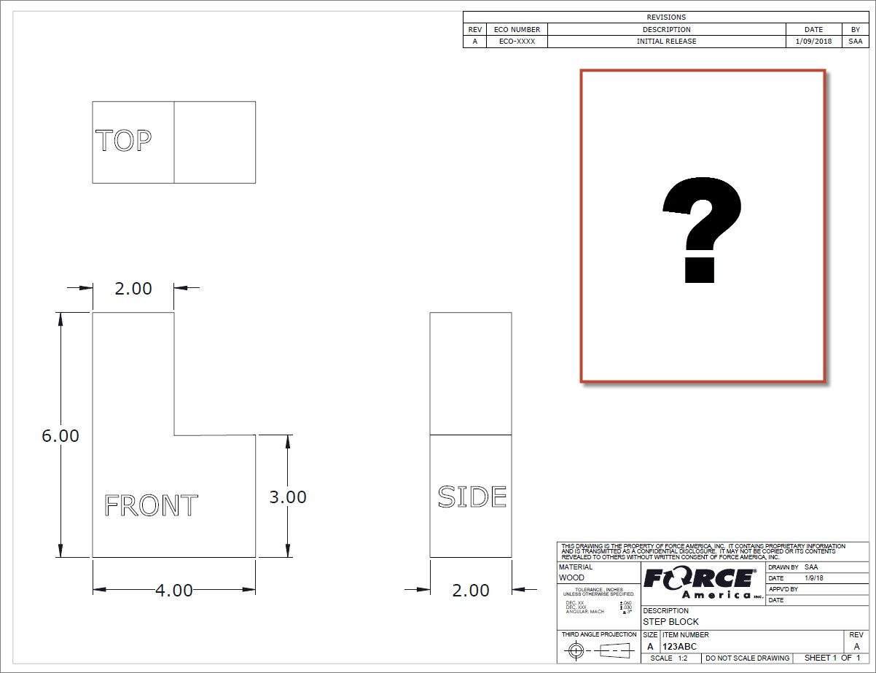
Orthographic Drawing

Slide 54
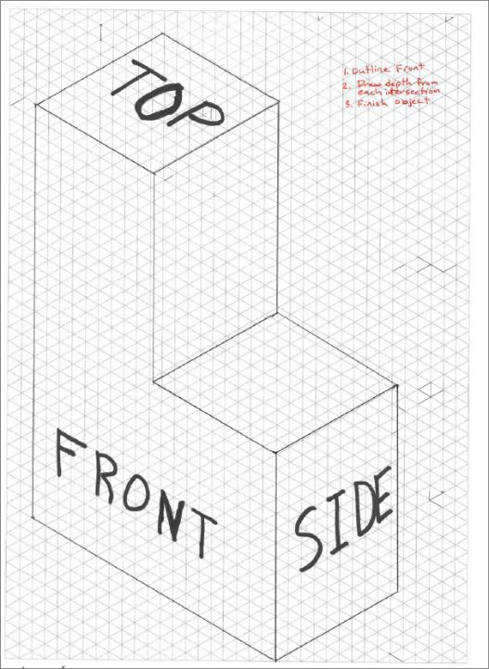
Isometric View
Always use Isometric Paper & Pencil,
as corrections are very common
Draw Front using the appropriate 30 degree direction on your paper.
Draw either the side or top depth
going 90 degrees from Front.
Finish your drawing by closing all of the sections.

Slide 55
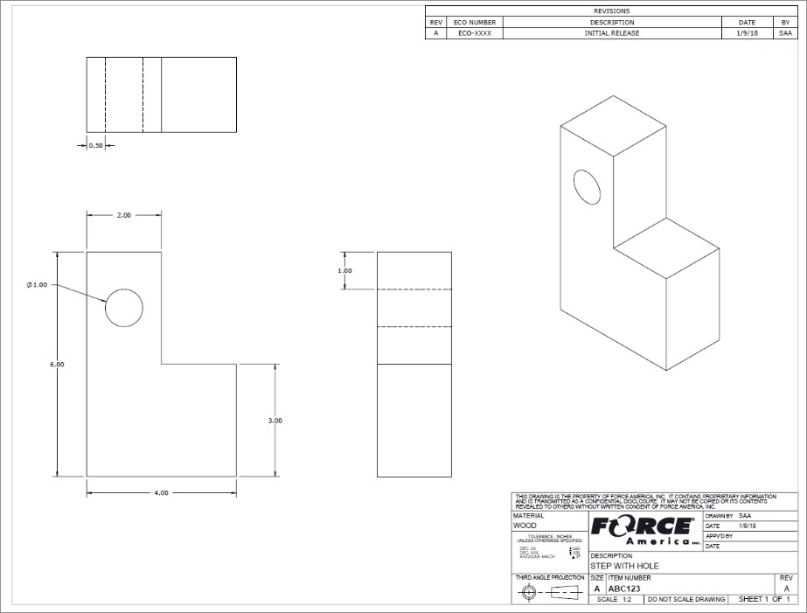
Hidden Lines
Dashed lines are used to define something that is underneath a solid object.

Slide 56
Orthographic & Isometric Recap
Drawings should have enough defining information listed
Orthographic projections shows 2D view of a specific side and should line up as if the item was being unfolded
Isometric shows a 30 degree offset view
Hidden lines are dashed lines in orthographic projections

Slide 57
The Challenge - Teamwork & Work Habits
The Challenge relies on teamwork to be successful
Successful teams:
Work together according to a time-line
Assign & divide tasks
Plan their work & work their plan
Complete tasks in parallel
Leverage individuals’ strengths
Don’t mess with other Teams materials without permission

Slide 58
This is the 2024-2025 Challenge layout board. Your team must build a device that sits in the Footprint Area and moves a wooden cylinder from the Start position to any one of the three target areas. An object placed upright on a target area is worth 1, 3, or 5 points, according to the area it is located in. The task is to accumulate as many points as possible in two minutes.
5
1
3

Slide 59
Discussion
Why is one destination position worth more points than the other? What if you design a device that only works when using your hands? How long will you have to move objects?
What tools/materials can you use to build your device on the Challenge Day?
Why is the Portfolio so important?

Slide 60
The Challenge Process
Objective
To design a device using only the supplied tools and materials, that will function and score as many points as possible.
Deliverable
Two copies of the portfolio
Challenge Kit
On the Challenge Day your team will bring your portfolio and tools. A Challenge Kit will be provided. It contains all the materials you will use including an extra piston syringe holder, two extra 20cc syringes and 6ft. extra tubing

Slide 61
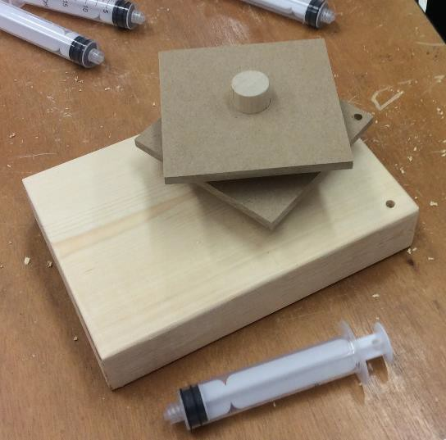
The Workshop kit and the Challenge Day kit contain a large wooden base with a hole to accommodate a large diameter dowel found in the kits. This can be used as a stable base if your team decides to do so. The hole is off-center and the dowel may require sanding to fit as your team wants.
The large dowel fits the two platforms in the kit. The picture shows that this team decided to drill a hole in the lower platform for a dowel and another hole in the base presumably for a rotating wheel with a piston holder fixed to it – an arrangement demonstrated by the Workshop Rotating Platform kit.

Slide 62
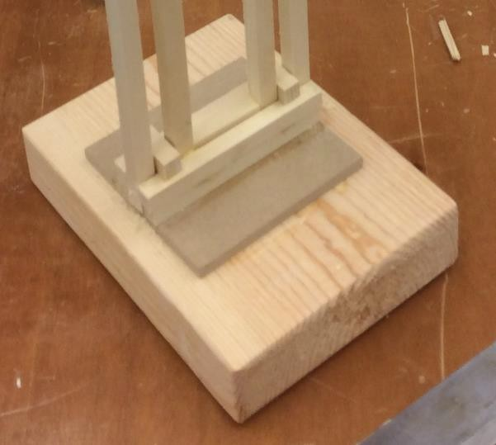
In this picture the large wooden base was used in a different way – there is no large dowel involved and a fixed structure is being built upon it

Slide 63
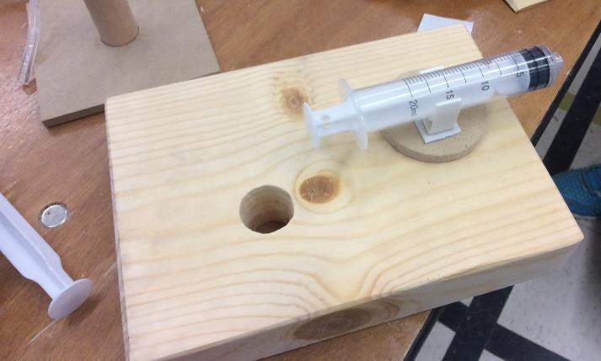
The Workshop kit and the Challenge kit both contain syringe holders. It has a “one- time” sticky pad on its base and must be pushed firmly onto a paper, plastic or a wooden surface to adhere sufficiently to hold the 20cc or 10cc piston syringe. A piece of “sticky” double-sided tape can be used with it if a larger area is required. Another piece of the same “sticky” double-sided tape can be used inside the cup to hold a 10cc piston syringe. Wood glue and hot glue are NOT efficient ways to secure this syringe holder.
The arrangement in the picture above may have potential problems. Why?

Slide 64
SAFETY is our #1 concern
ALL motion must be controlled by fluid power
USE your materials wisely
DOCUMENT everything in your portfolio
All materials to build device are provided
Bring tools
Use your time efficiently
Have fun and work well

Slide 65
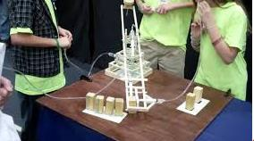
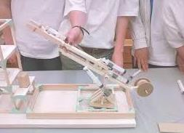
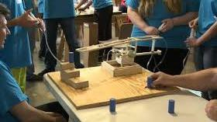
Examples of previous projects
YouTube & Google
“Fluid Power Challenge”
Challenge Video 2 Challenge Video 3

Slide 66
The Portfolio Review Template and Checklist
The Portfolio Review Template is considered the minimum
requirement for your team’s portfolio.
The Checklist is a sample Index for your Portfolio
See sample Portfolio on Resources Center: http://nfpahub.com/fpc/resources/#!/event/25

Slide 67
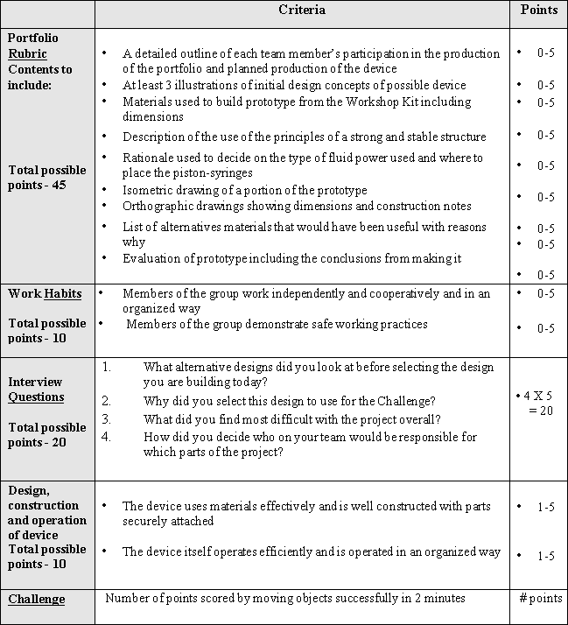
HINTS & TIPS continued:
Points are given for each sub-category and for the overall performance of your team’s device
Discussion
How many points are awarded without competing with your device?
What pre-challenge actions can you take to get the most Teamwork Skills points?
What can your team do to do well in the Interview?

Slide 68
MAXIMISE YOUR TEAM’S PORTFOLIO POINTS
Outline of the division of labor based on each member’s skills and the time available to complete portfolio
Think about your team – who is good at what?
Think about how long you have to design and build your prototype and
record the process in your portfolio
At least three illustrations, no matter how detailed, of initial design concepts
However, detail helps you think about the connecting parts!
Detailed list of materials used
Record the parts you use and their dimensions
List of alternative materials that would have been useful with reasons why they would have been so
This is asking you to think “outside the box” literally

Slide 69
Sketching is a way of communicating ideas

Slide 70
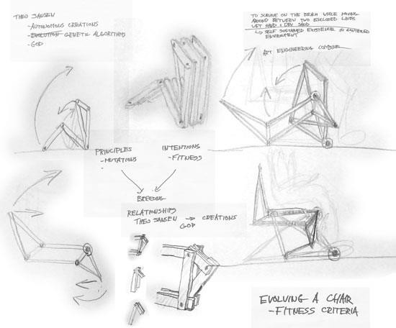
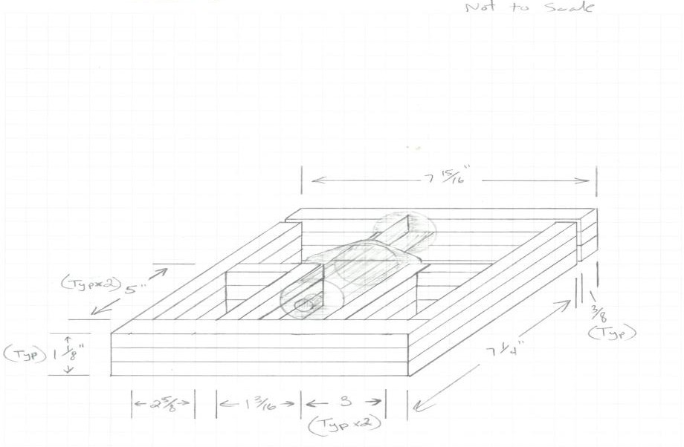
Sketching is a way to explore new ideas.

Slide 71
Examples of team tasks:
Read project rules
Research clamping mechanisms
Sketch ideas for clamping mechanisms
Research rotating mechanisms
Sketch ideas for rotating mechanisms
Research rotating mechanisms
Build prototype mechanisms
Sketch whole robot design
Build a whole prototype
Practice challenge activity
Read portfolio scoring rubric
Generate final sketches of design for
portfolio
Write a description of the principles of strength and stability
Write an explanation of the chosen location of your syringes
Have writing reviewed by a mentor
Assemble all portfolio elements into a final report
Who will be responsible for what?

Slide 72
Identify concrete tasks and milestones
Read rules and scoring rubrics
Build prototype rotating mechanism
Have draft portfolio reviewed by a mentor
Milestone: Assemble writings and sketches into final portfolio
Milestone: Finalize robot design
Research clamping mechanisms

Slide 73
What you should be doing right now
Identify 3 tasks or milestones
Lay out the schedule
Choose dates for your milestones

Slide 74
Watch videos from previous Fluid Power Challenges on
YouTube or Google web (“Fluid Power Challenge”)
Successful products are always made by carefully researching existing products.

Slide 75
Remember, we will see you
in approximately
2 weeks (Feb. 17th-21rd)
for a mid-project status visit
At
your school

Slide 76
On Challenge Day – Time Is Limited
We will be conducting 2 Minute Timed Events. (Maximum of 4 minutes on the Challenge Table which includes 1 minute of trial run/minor repairs, 2 minute event and 1 minute judges inspection.).
There won’t be enough time for everyone to go multiple times as in the past. You will only have one shot to compete. **MAKE SURE IT COUNTS**

Slide 77
Mid-Project Review Feb, 17th -21st
Challenge Day March 10th!

